Slide 1
SECURE DATA HIDING IN IMAGES USING STEGANOGRAPHY
CAPSTONE PROJECT
Presented By:
Student Name : Pranavi Hampanoor
College Name & Department : SVCE-CSE(Cyber Security)

Slide 2
OUTLINE
Problem Statement
Technology used
Wow factor
End users
Result
Conclusion
Git-hub Link
Future scope

Slide 3
Problem Statement
Traditional security methods expose sensitive data to detection and interception. This project leverages steganography to embed secret data within digital media, ensuring covert communication. It aims to develop a secure, efficient system for encoding and decoding hidden messages while preserving file integrity and minimizing detection risks.

Slide 4
Technology used
The technologies, libraries, and platforms used in this steganography project :
Category | Technology/Library
Programming Language | Python
Libraries | OpenCV, OS
Cryptographic algorithm | AES128
Platform/Environment | Windows/Linux/macOS
Tools(Optional) | Visual Studio Code/Jupyter Notebook

Slide 5
Wow factors
Direct Pixel Manipulation : Encodes message characters directly into pixel values instead of using LSB.
Custom Character Mapping :Uses a dictionary for ASCII-to-pixel value mapping for efficient encoding.
Password-Protected Decryption : Requires a passcode to extract hidden messages, adding security.
End-of-Message Marker (~) : Ensures accurate message extraction by marking termination.
Automated Image Display : Opens the encrypted image automatically after encoding.
Lightweight & Standalone : Uses only OpenCV and built-in libraries, requiring no extra dependencies.

Slide 6
End users
Banking & Financial Institutions – Safeguard transaction details and client data.
Military & Defense Organizations – Secure battlefield communications and intelligence operations.
Law Enforcement & Intelligence Agencies – Covertly exchange classified data for investigations.
Journalists– Share confidential information without attracting attention.
Corporate Organizations – Protect trade secrets and sensitive business data.
Government Agencies – Secure diplomatic and confidential communications.
General Users & Privacy Enthusiasts – Securely hide personal data in images.

Slide 7
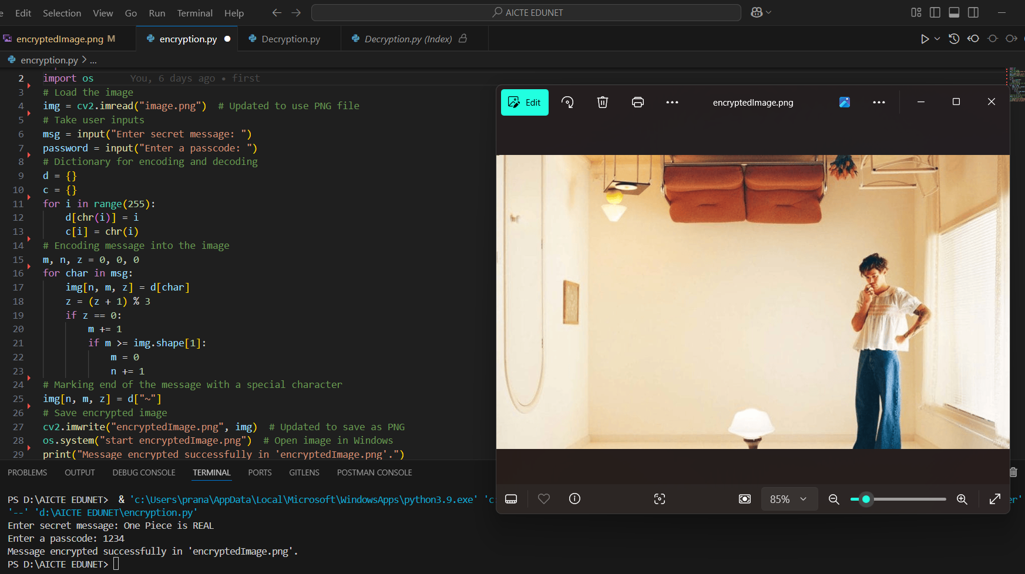
Results
Encryption: Hidden Messages in Image Pixels with Steganography

Slide 8
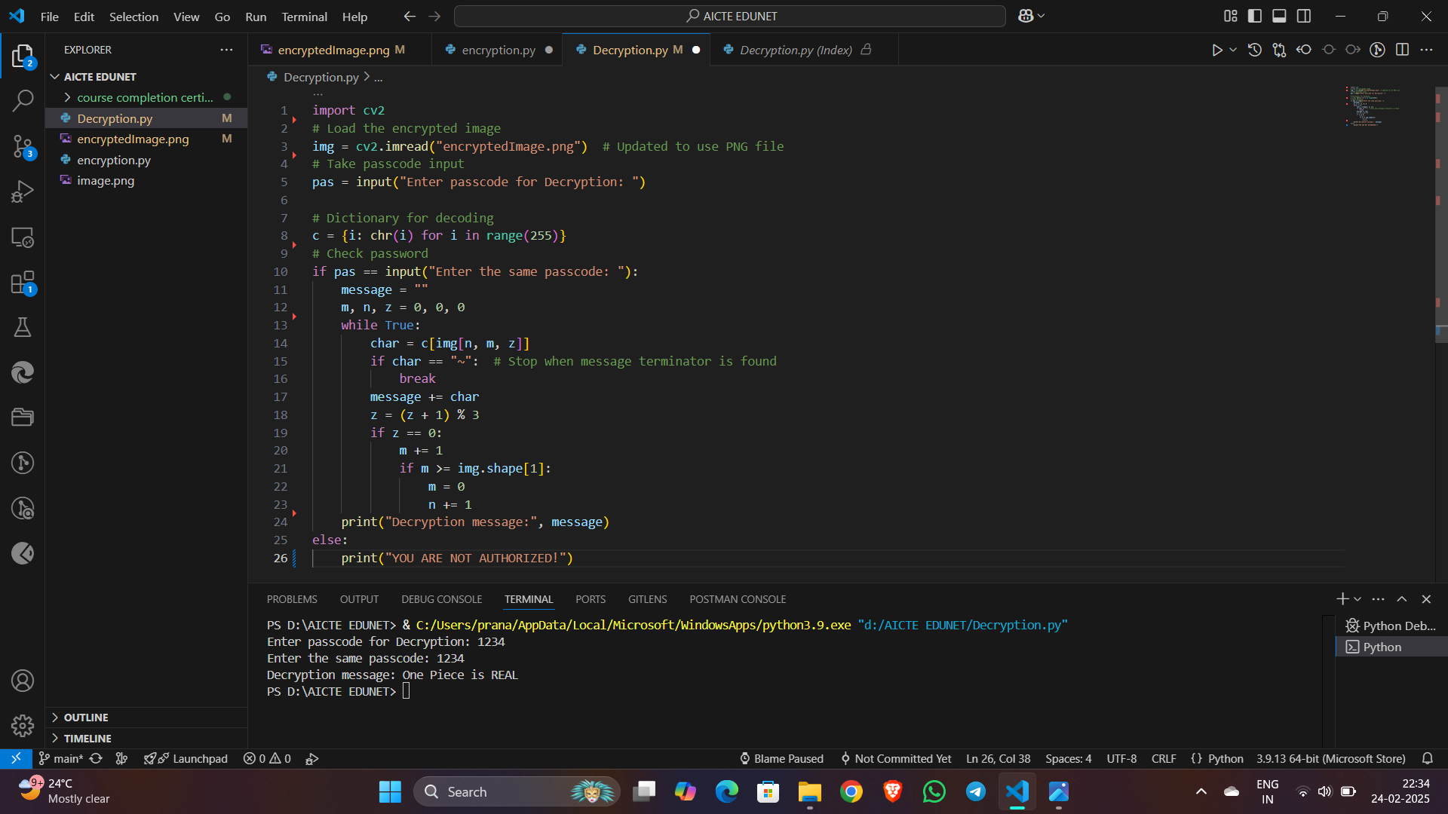
Decryption: "Secure Decryption with AES Algorithm

Slide 9
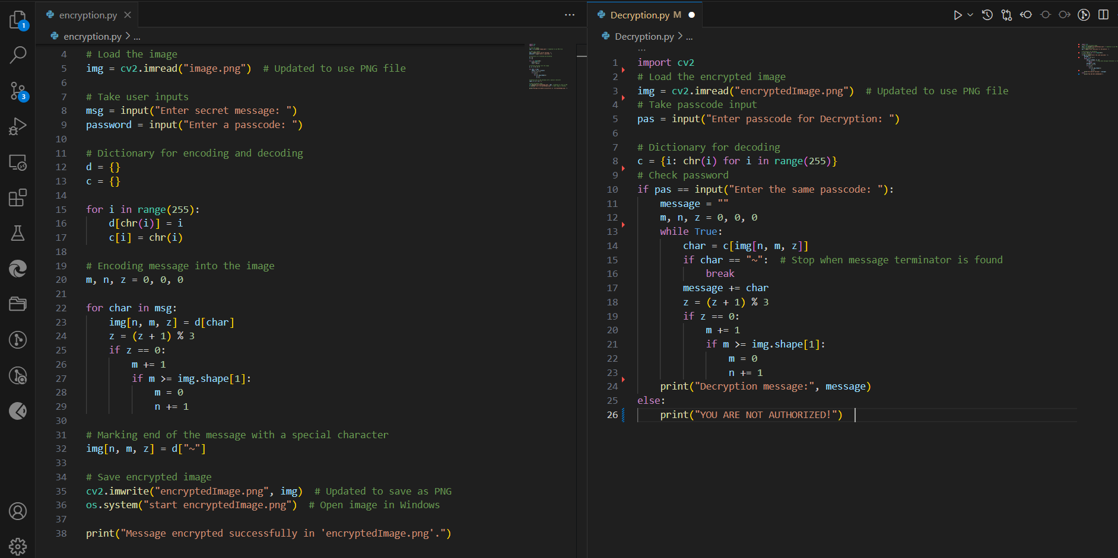

Slide 10
Conclusion
This project provides a secure and efficient steganography system by embedding messages directly into image pixels and securing them with password protection,it ensures confidentiality and minimizes detection risks. The use of custom character mapping and an end-of-message marker enhances accuracy and reliability. This solution provides a robust and efficient approach for securely transmitting sensitive information across various domains, including cybersecurity, military, corporate, and personal privacy applications. Overall, this system provides a robust, covert communication tool that minimizes detection risks while ensuring data integrity.

Slide 11
GitHub Link
https://github.com/Pranavi1410/AICTE-Edunet-Steganography-Project

Slide 12
THANK YOU

